Slide 1
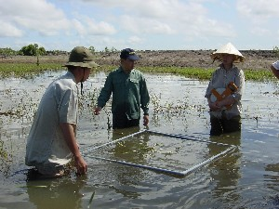
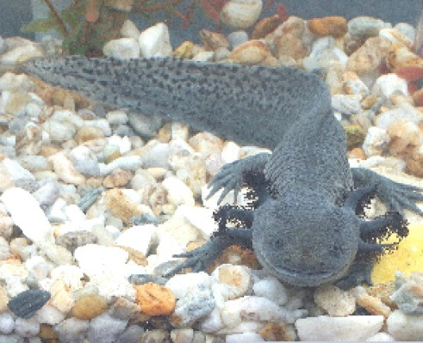
The Darwin Initiative
Workshop for New projects

Slide 2
Objective of the Day
To provide an introduction to the Darwin Initiative and what it entails for projects
To meet the Darwin Initiative key people and understand their role
To get an insight of the administration and reporting requirements under DI
To meet other Darwin project staff and build links between projects
To improve project ability to demonstrate evidence of impact

Slide 3
Agenda - Morning
Welcome and Introductions
Introduction to Darwin reporting systems
Promoting Darwin projects
Welcome by the Darwin Secretariat
Theory of Change
Lunch!

Slide 4
Agenda - Afternoon
SMART indicators
Developing an M&E plan
Communications
Group Exercises
Highlights and Wrap Up

Slide 5
Introductions
Introduce yourself and your project:
Name
Institution
Project title only
History with Darwin?

